Slide 1
Instruction and Interrupt Cycle

Slide 2
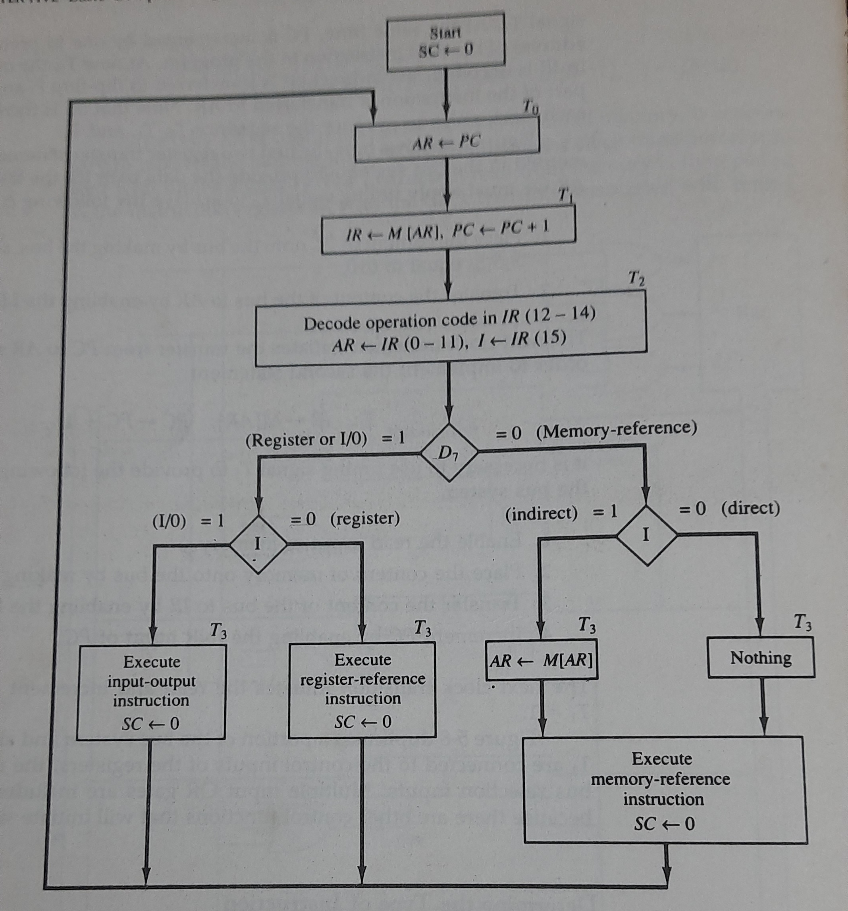

Slide 3
